Slide 1
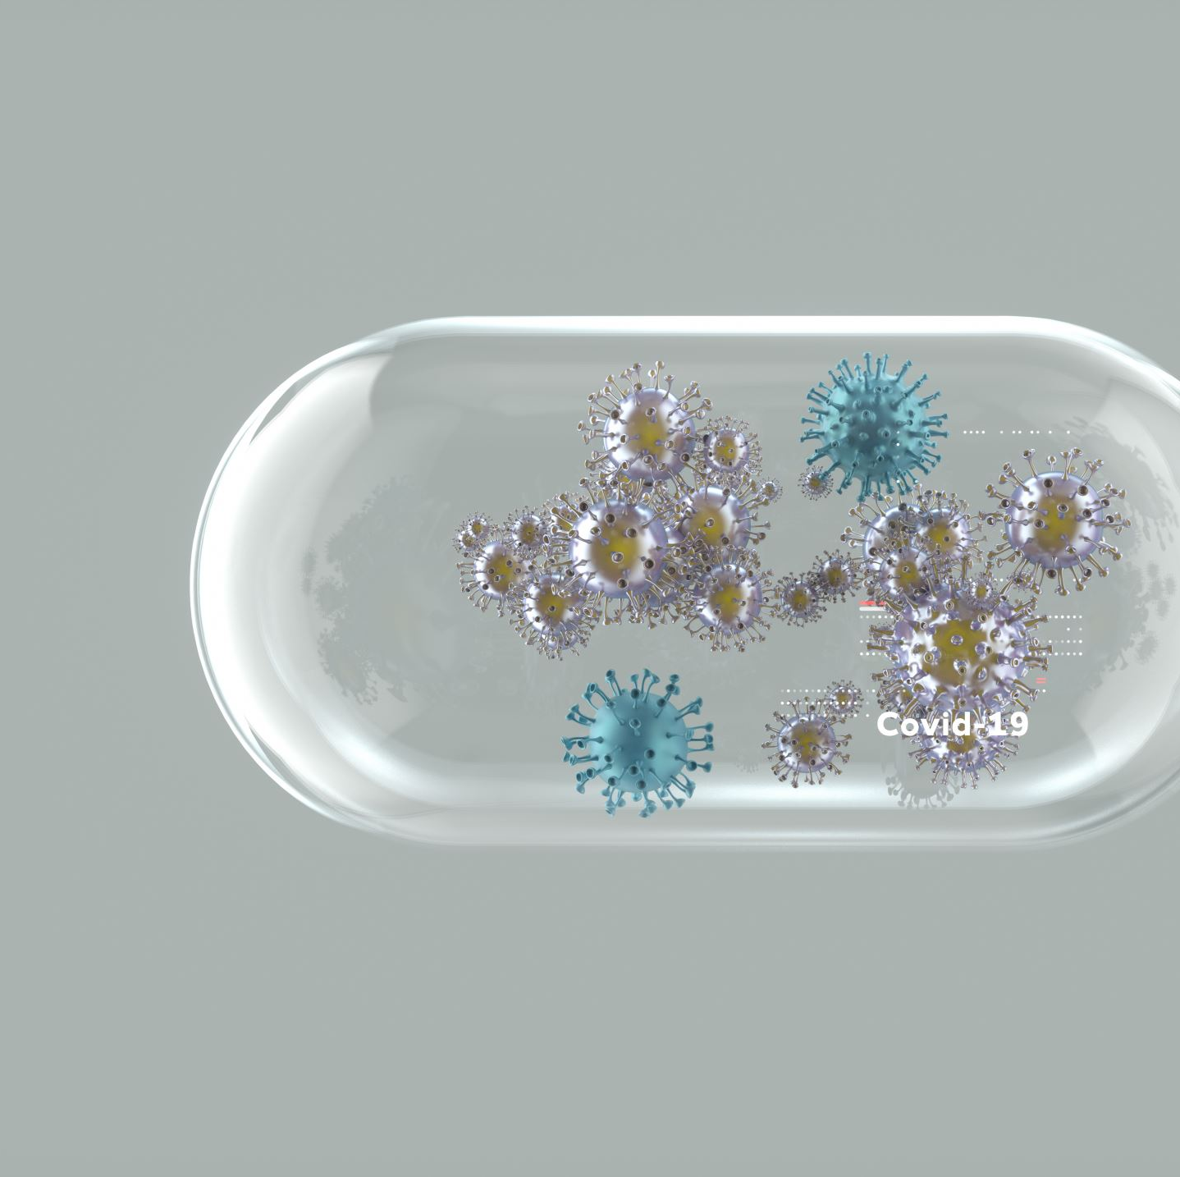
Cheek Cell Collection on a Glass Slide

Slide 2
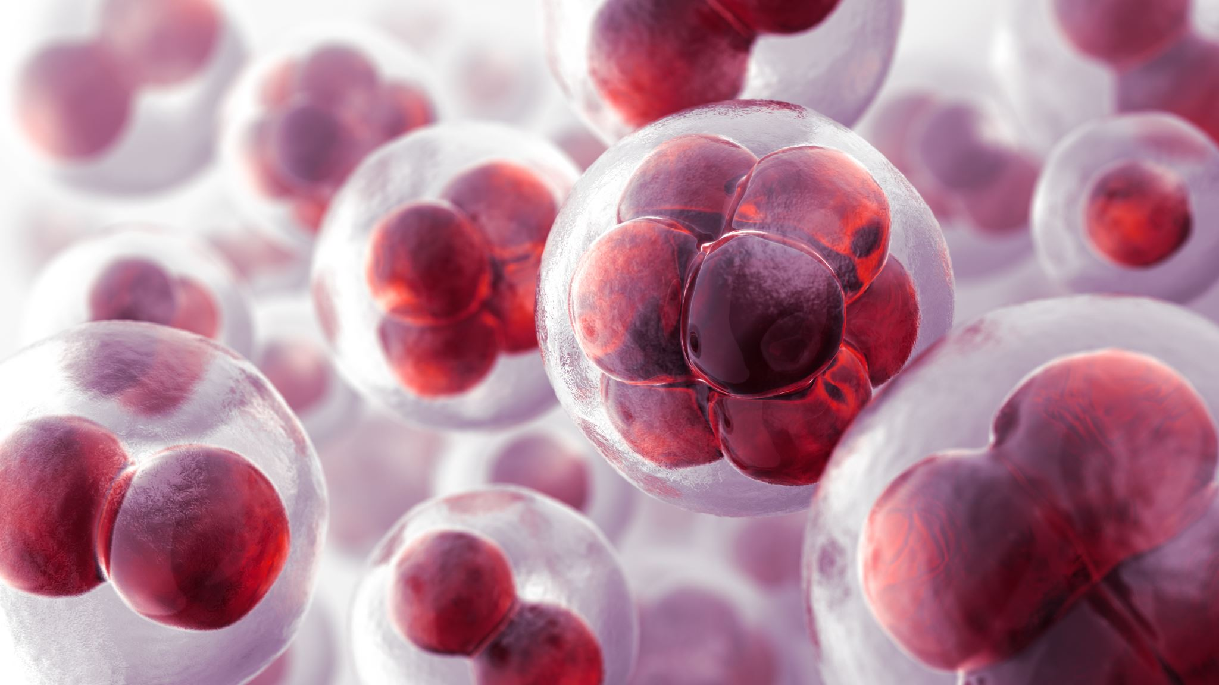
What is the Purpose of Collecting Cells?
Collecting cells is a method of diagnosing disease
Cells can be collected from every part of the body
Skin
Mouth
Lungs
Bladder
Other internal organs (stomach, liver, intestines, etc.)

Slide 3
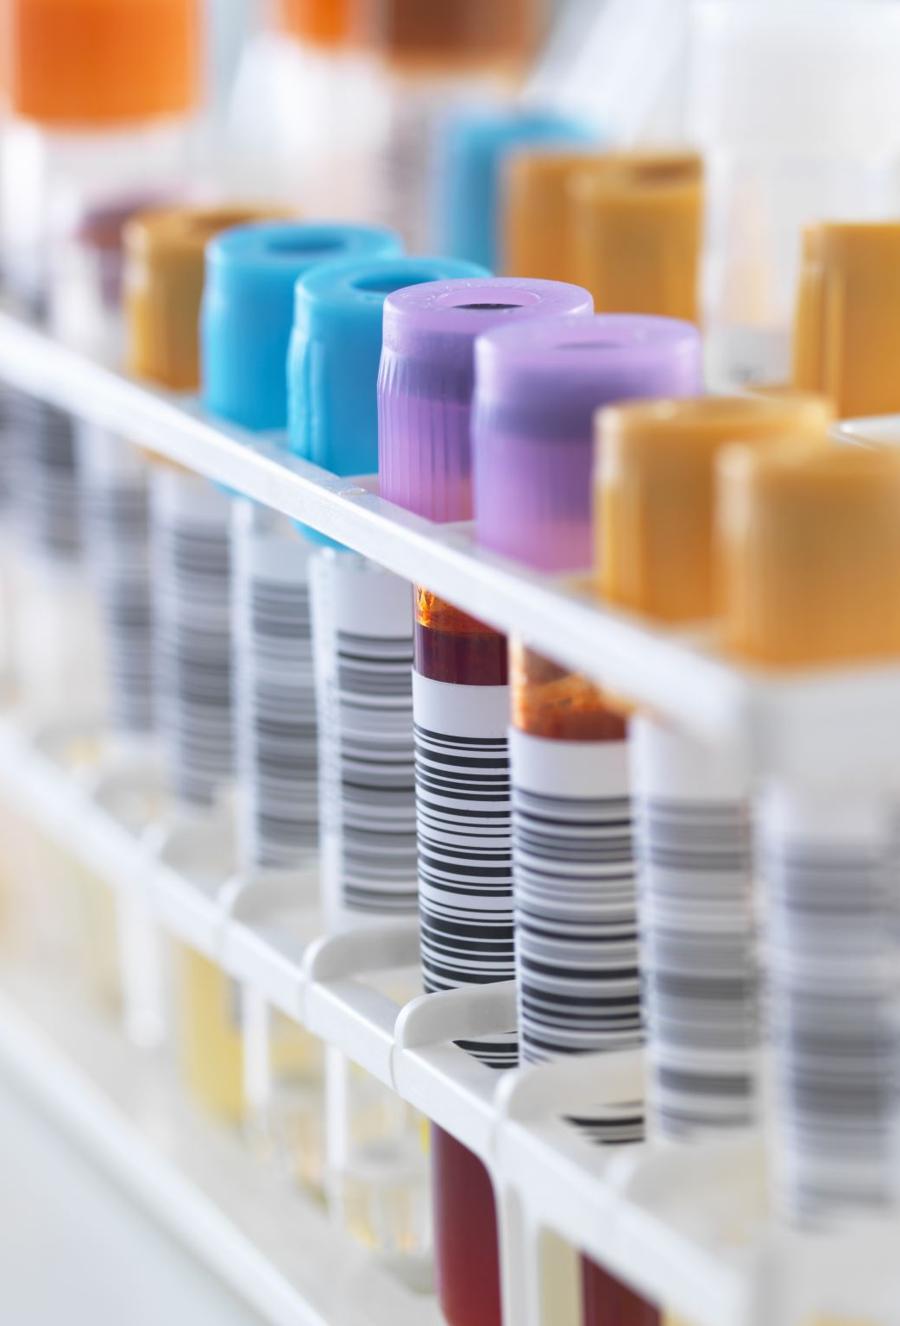
There is a special method for collecting cells for each body site:
Spatula and brush method examples: Skin, mouth, respiratory tract, reproductive system
Exfoliative method examples: Urine (urinate in a cup)
The cells are collected and smeared onto a glass slide, stained with special dyes, and examined under the microscope.

Slide 4
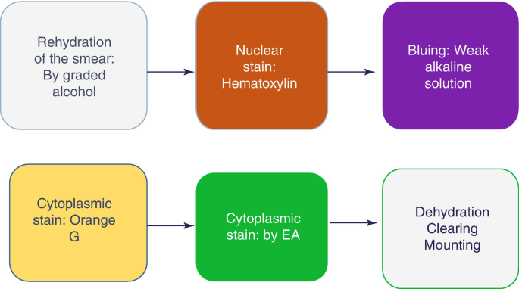
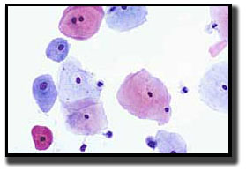

Slide 6
Step 1: Make sure you have the following items:
Glass slide
Cover slip
Pap Stains and Reagents
Popsicle stick

Slide 7
Step 2: Place glass slide in front of you.
Step 3: Take popsicle stick and gently rub the inside of your cheek.
Step 4: Smear the popsicle stick onto the glass slide.
Step 5: Place glass slide in 95% alcohol.
Step 6: Follow the Pap stain protocol for staining cells.

Slide 8
Pap Stain Procedure

Slide 9
Please Click the Following Link to the Tutorial on the basics of the Pap Stain: https://www.laboratory-ops.com

Slide 10
What Kinds of Cells are in the Oral Cavity?
Squamous Cells
Function: protection
Resists trauma & changes in temperature
Two types:
Keratinized stratified squamous epithelium
Found on the hard palate
Nonkeratinized stratified squamous epithelium
Found on the cheeks, soft palate, and other soft areas in the mouth

Slide 11
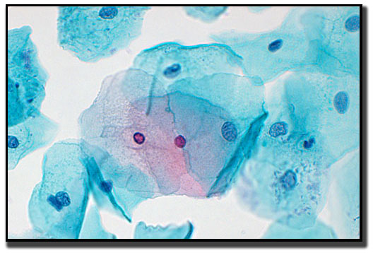
Intermediate Squamous Cells
Superficial Squamous Cells

Slide 12
Why do we look at cells under the microscope?
To diagnose pre-malignant diseases (pre-cancer)
To diagnose malignant diseases (cancer)
To identify microorganisms that cause infection

