Slide 1
Health data literacy
Rebecca Reynolds

Slide 2
On the internet…. no one knows you are a dog!

Slide 3
Learning objectives
Identify and use resources that provide high-quality health information
Identify an example of a reputable source for health information.
Describe how various sources of information influence personal health behaviors

Slide 4
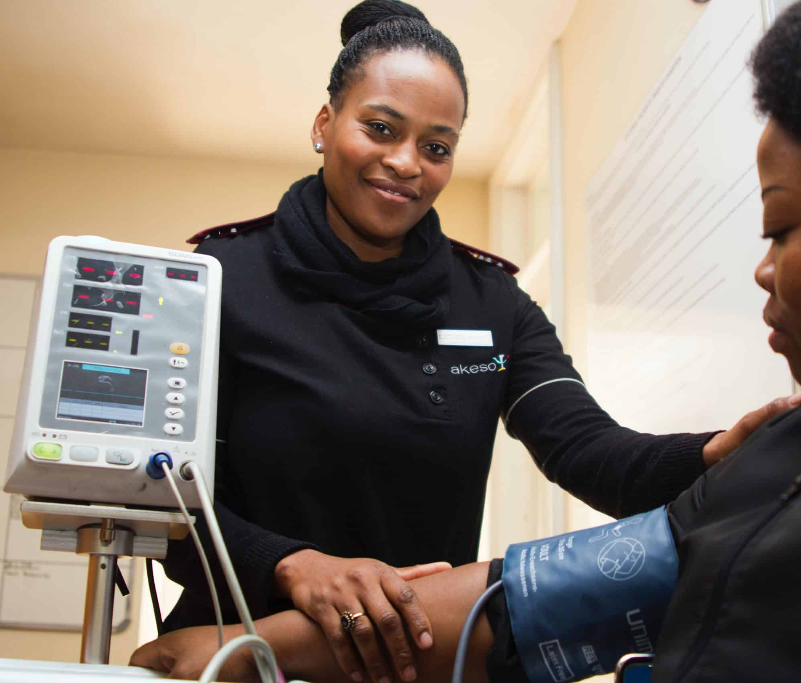
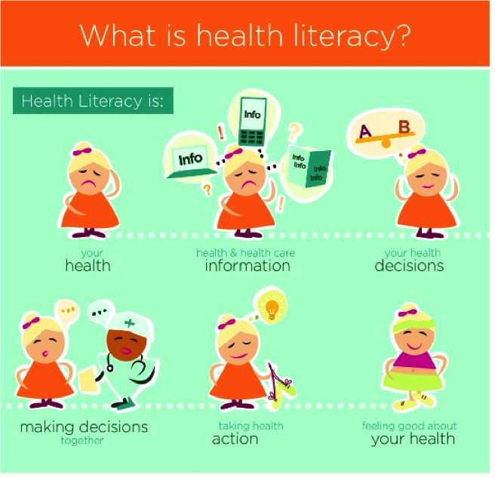
Health information literacy
Health information literacy incorporates both health and data literacy, and is defined by the Institute of Medicine as the “degree to which individuals have the capacity to obtain, process, and understand basic health information and services needed to make appropriate health decisions.”
This Photo by Unknown Author is licensed under CC BY-NC
This Photo by Unknown Author is licensed under CC BY-SA-NC

Slide 5
3 steps for health information literacy
Obtain—how to access health data
Process—how to read and interpret health data
Understand—how to know what to do with health data
Notes:
Have students discuss what this means and give examples.

Slide 6
What is health data literacy? National Action Plan to Improve Health Literacy | health.gov
What is data literacy? The ability to read and interpret data
The importance on knowing how to read data
Data is becoming more ”code-free” and allow people to review algorithms and outputs
Health literacy is the capacity to obtain, process and understand basic health information and services.
This is necessary to make health decisions
Notes:
The Action Plan contains 7 goals that will improve health literacy and strategies for achieving them:
Develop and disseminate health and safety information that is accurate, accessible, and actionable
Promote changes in the health care system that improve health information, communication, informed decision-making, and access to health services
Incorporate accurate, standards-based, and developmentally appropriate health and science information and curricula in child care and education through the university level
Support and expand local efforts to provide adult education, English language instruction, and culturally and linguistically appropriate health information services in the community
Build partnerships, develop guidance, and change policies
Increase basic research and the development, implementation, and evaluation of practices and interventions to improve health literacy
Increase the dissemination and use of evidence-based health literacy practices and interventions
National Assessment of Adult Literacy (NAAL)
There are typically 4 levels –below basic, basic, intermediate and proficient

Slide 7
Why is health information literacy important?

Slide 8
It can be harder for people to use technology for health-related tasks when they:
have lower health literacy in general.
don’t have access to or experience using a tech device like a smartphone or a computer.
don’t have access to high-speed internet.
have a disability like not being able to hear or see well.
don’t have people in their homes who could help them use technology.
don’t have health technology apps or websites available in their preferred language.

Slide 9
Do we have access in Tennessee?
Tennessee digital divide
Link to state map that students can look at county level data.
https://utextensionced.tennessee.edu/digital-divide-index/

Slide 10
Questions to think about
If you wanted to find out something about a health topic, where might you look? Who might you talk to?
Where do you go to for health information? (These could include news sites, blogs, YouTube, or others.)
Who are the people or accounts you follow on social media?
Who are some people that you go to for health information that you trust?
Who are the people you know in real life whose opinions you trust? (Friends count!)

Slide 11
What is a URL?
Uniform Resource Locator—it is the address of a web page
Com
Edu
Notes:
These could be listed or ask students to name them and then display them and move on the next slide and discuss.

Slide 12
What do you know about URLs?
com = commercial. Often companies that make money
.edu = educational institution. Often universities
.gov = government. Usually federal, state, and local agencies
.net = network. Could be any site
.org = organization. Most often is a nonprofit organization
Notes:
This can be done as a quiz or class participation and then go over the meaning for the URLs

Slide 13
Steps to improve your health literacy
https://www.movinghealthcareupstream.org/wp-content/uploads/2022/11/Checklist-Owning-Your-Own-Health.pdf
Notes:
This is a link to a worksheet that students can use to think about things that they need to know in order to transition to taking care of their own health care. There are other modules in the teacher kit that you can use to talk about OTC medications.

Slide 14
Health data literacy is an important workplace skill
85% of executives believe data literacy will become as vital in the future as the ability to use a computer is today.
US workers who can demonstrate their data literacy skills can expect a 20% salary increase.
78% of global employees are spending time every month investing in their own personal development. These employees are spending an average of nearly seven hours on personal upskilling each month at an average cost of $2,800 over the last 12 months.
Source: Data Literacy to be the most in demand skill by 2030 | Qlik

Slide 15
The role of the HIIM professional
Are data valid so anyone can have an understanding of what data is relevant for your objectives?
Do you know how to interpret data so the results are useful and meaningful?
Do you know how to visualize the data and create a story that others can understand the data?

Slide 16
“develop and evaluate…predictions that are based on data.”
Learning how to read, work with, analyze and communicate with data has practical advantages for career opportunities down the line.

Slide 17
You don’t want to get health information from a dog!!

Slide 18
Assessment
Is This Legit? Accessing Valid and Reliable Health Information | National Institute on Drug Abuse (NIDA) (nih.gov)
Complete the “Is this Legit?” worksheet and be prepared to discuss
Notes:
Students can work in teams or this can be a homework where they use this tool
The National Institute on Drug Abuse has other lesson plans that teachers can use also.

Slide 19
Teacher resources
https://ahimafoundation.ahima.org/understanding-the-issues/building-health-and-data-literacy-in-k-12-schools/

